Slide 1
Exam 2 Key
ChE 384T/323 Chemical Engineering for Micro/Nano Fabrication
Fall 2018
2018-11-20

Slide 2
Average Score
Total of 8 questions (Q4 is same as Q9. Full credit given to everyone)
Raw average score = 55/90
+10 (for Q9)
+10 (to increase average to B+)
Graduate student average score = 70
Undergraduate student average score = 77
Note that the lower score of Exam 1 or 2 will be dropped
For any questions about grading, please refer to the initials next to the grading sheet and contact the grader-in-charge

Slide 3
Key concepts/words are important to get full credit
Try to review lecture notes and identify the main message (key concept, key words, key design principle) behind each slide/figure

Slide 4
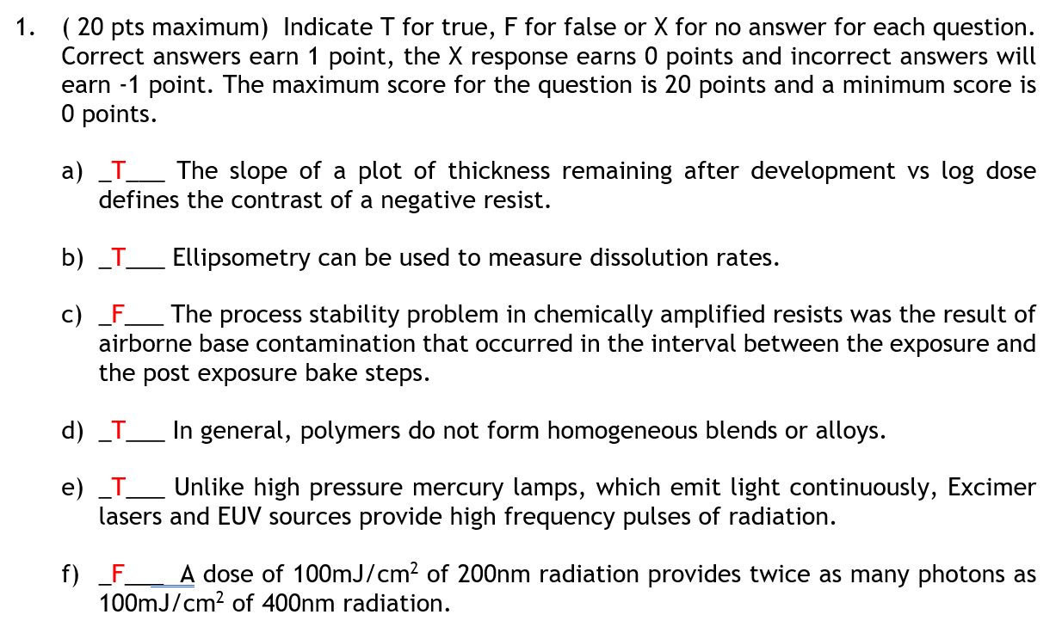
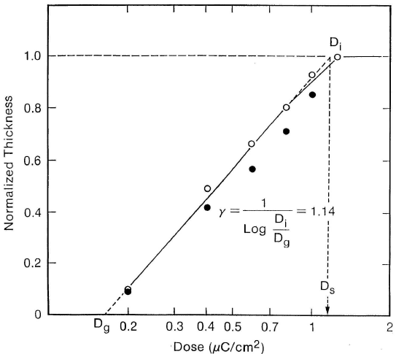
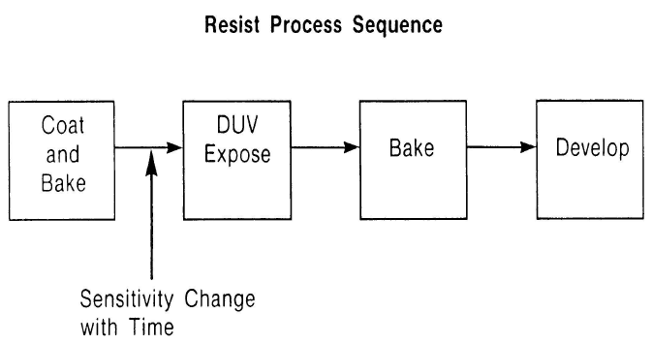
Q1: True/False Question (Please don’t gamble!)
L18, #11
L20, #27
L20, #16
L20, #3

Slide 5
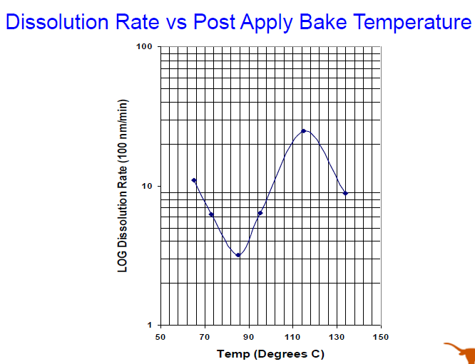
Q1: True/False Question (Please don’t gamble!)
Morgan’s Lecture
If it is the same, cannot have opposite in phase to reduce the back reflections
SADP is a conformal process
L17, #25
L2, #29

Slide 6
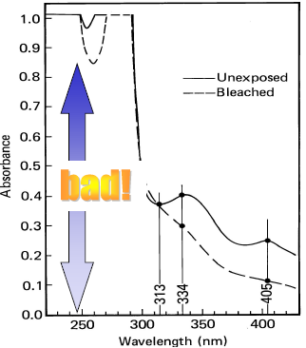
Q1: True/False Question (Please don’t gamble!)
L19, #5
L8, #15
L19, #6
L18, #14

Slide 7
Q2: Resist Design Principle
L16, #16

Slide 8
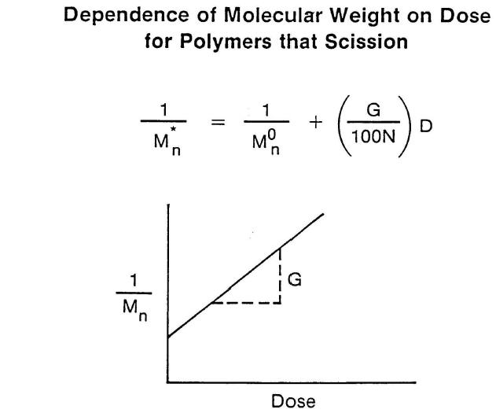
Q3: Concept of a G-value

Slide 9
Q4: Resist Design Principle

Slide 10
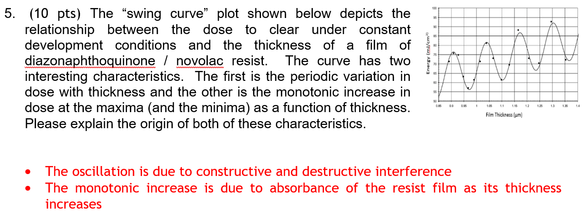
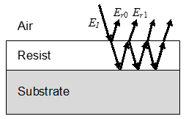
Q5: Swing Curve
Xin yang’s lecture

Slide 11
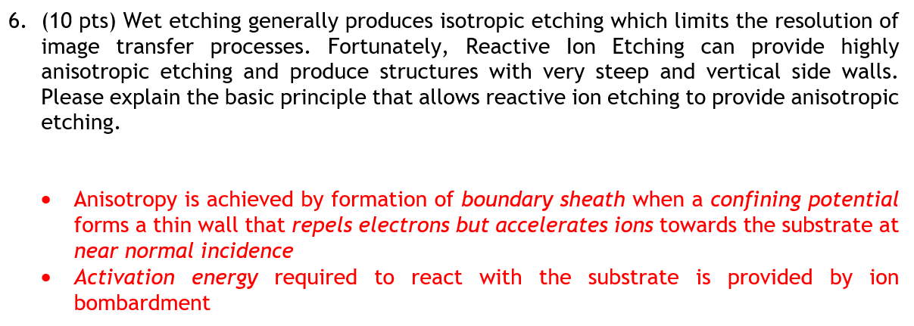
Q6: Design Principle of Anisotropic Etching
Dr. Sirard’s lecture

Slide 12
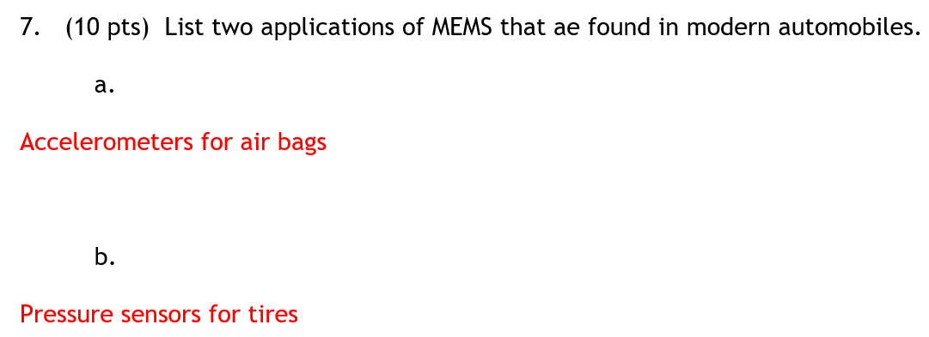
Q7: Applications of MEMS

Slide 13
Q8: Resist Sensitivity and Contrast Curve
Similar to Quiz

Slide 14
…and please let us know how we can help!

